Slide 1
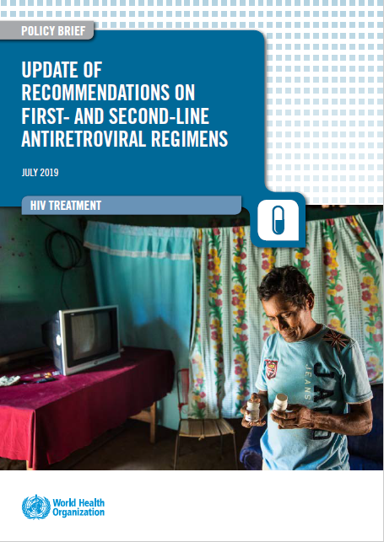

What’s new in the 2019 WHO Guidelines:
Dolutegravir based regimens in first- ad second-line HIV Treatment
Meg Doherty, MD, PhD, MPH
WHO Geneva
Sunday 21 July, 2019

Slide 2
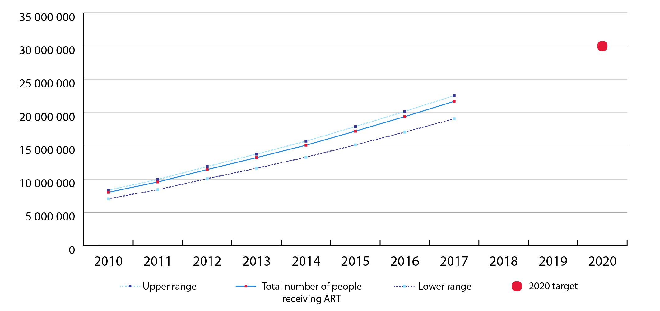
Increase in people receiving ART over time
(62% ART coverage)
Source: UNAIDS/WHO estimates

Slide 3
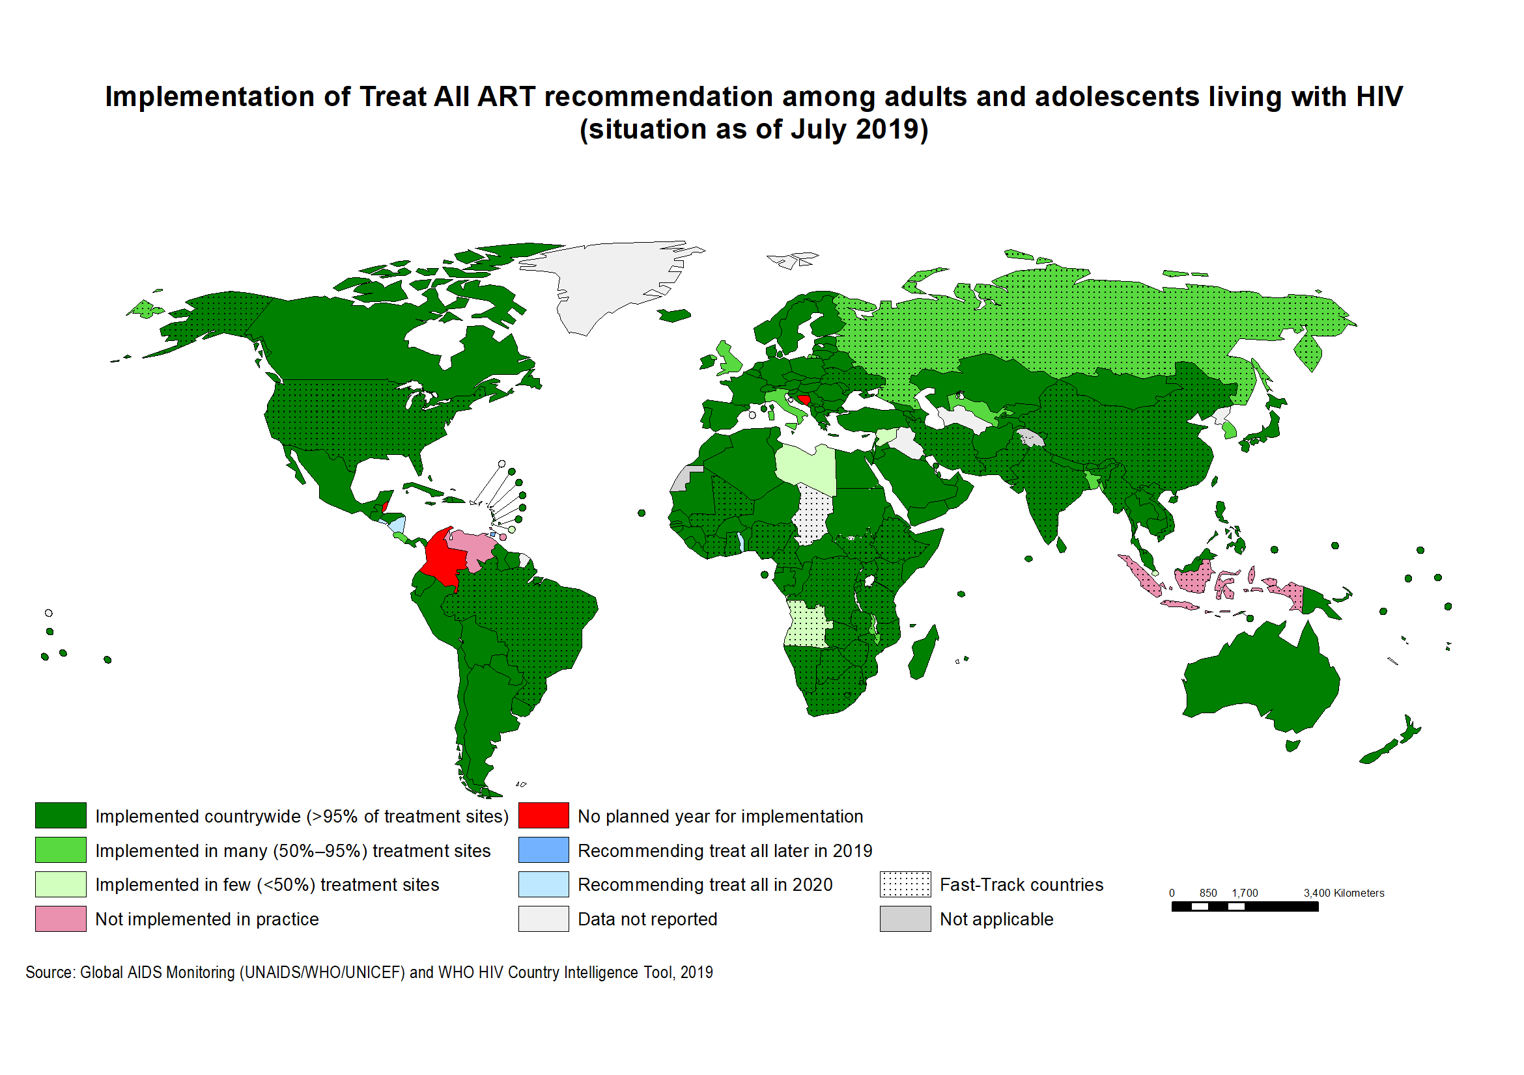
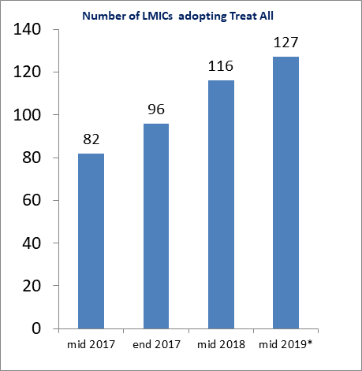
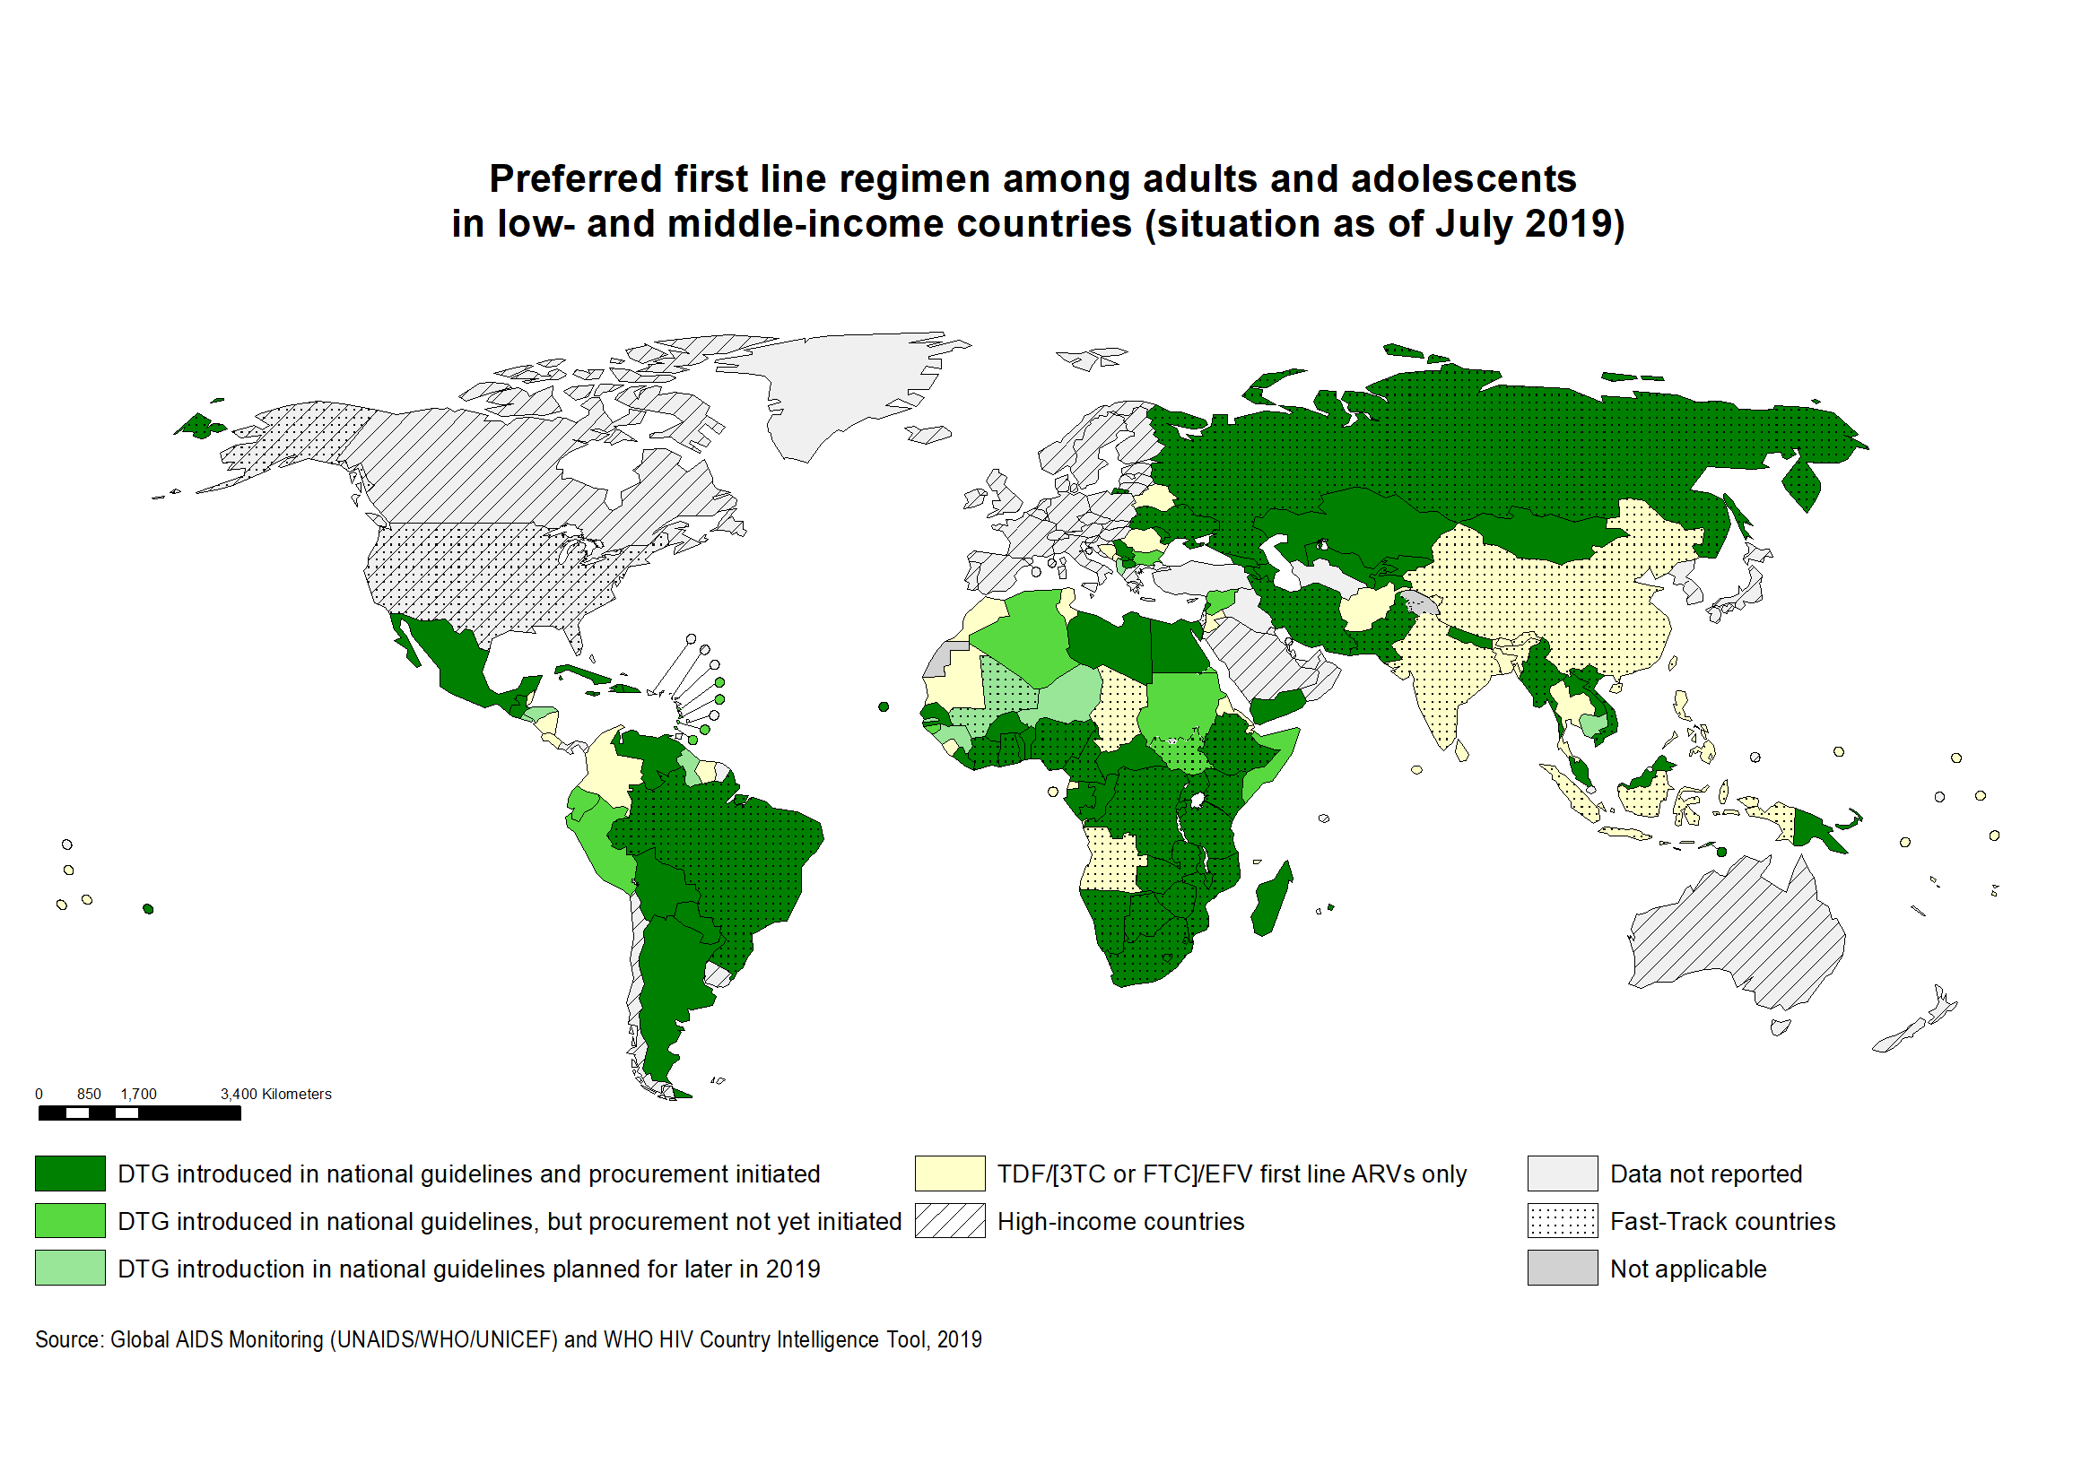
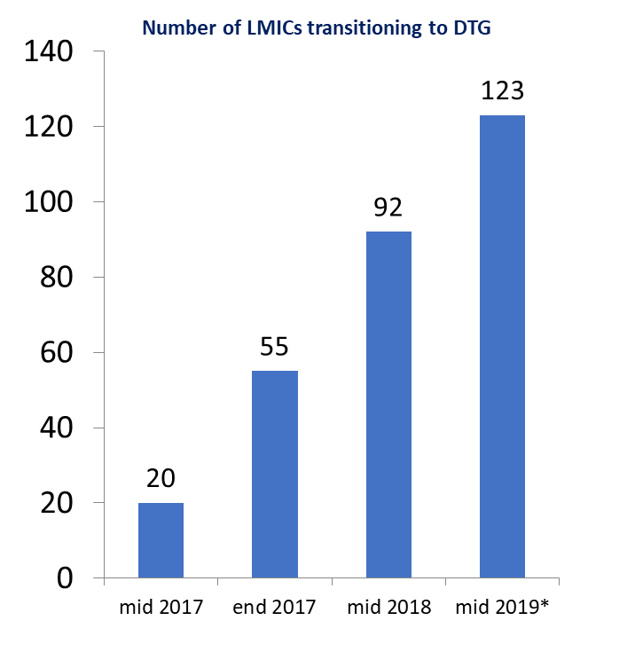
Uptake of major HIV treatment policies in LMICs
Treat All
DTG transition
* Preliminary data

Slide 4
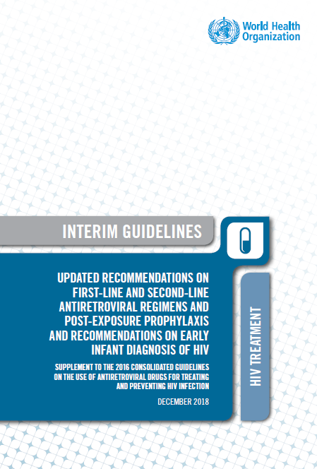
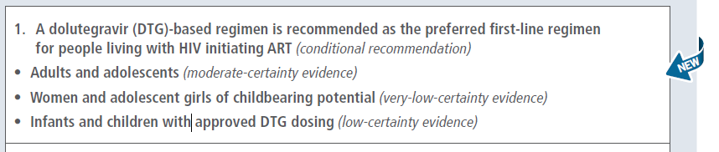
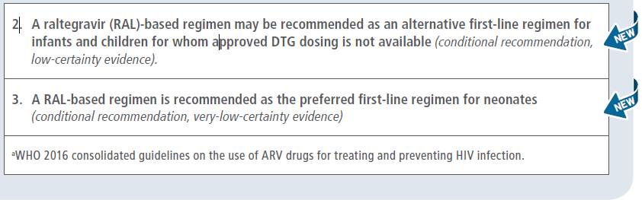
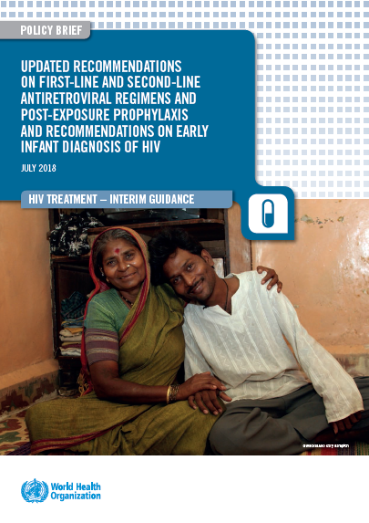
2018 WHO recommendations: First-line ART regimens

Slide 5
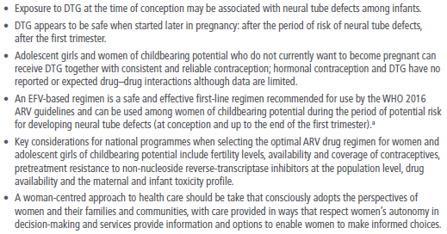
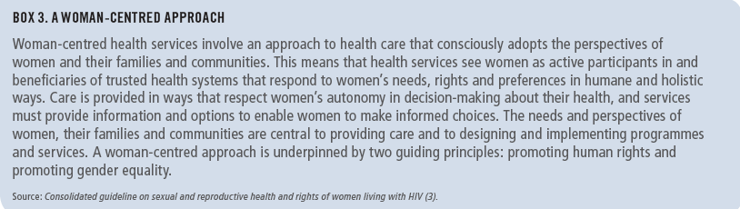
Note of caution for using DTG in women and adolescent girls of childbearing potential

Slide 6
2018 interim recommendations on 1st line, 2nd line and PEP
ART guidelines section | Major recommendations | Strength of the recommendation |  | Quality of the evidence to guide the recommendation
 |  | Strong | Conditional | High | Moderate | Low | Very Low
Recommended 1st line ARV regimens in PLHIV | DTG in preferred 1st line regimen in adults and adolescents
 | DTG in preferred 1st line regimen in women and adolescent girls with childbearing age potential
 | DTG in preferred 1st line regimen in infants and children with approved DTG dosing
 | RAL in alternative 1st line regimen in infants and children whom DTG dosing is not available
 | RAL in preferred 1st line regimen in neonates
Recommended 2nd line ARV regimens in PLHIV | 2 NRTI + DTG as preferred 2nd line regimens for adults and adolescents whom DTG containing regimen are failing
 | 2 NRTI + DTG as preferred 2nd line regimens for children with approved dosing whom non-DTG containing regimen are failing
PEP-HIV | A HIV PEP regimen with 3 drugs as preferred in adults, adolescents and children
 | TDF + 3TC (or FTC) as preferred NRTI backbone for HIV-PEP in adults and adolescents
 | AZT + 3TC as preferred NRTI backbone for HIV-PEP in children
 | DTG as preferred 3rd drug for HIV-PEP in adults, adolescents and children with approved dosing
 | ATV/r, DRV/r, LPV/r or RAL as alternative 3rd drug for HIV-PEP in adults, adolescents and children

Slide 7

PICO questions for 2019 update
PICO 1a: Should DTG-based regimens be recommended as the preferred first-line with an NRTI backbone for the treatment of HIV in adults and adolescents?
PICO 1b: Should PI-based regimens be recommended as the alternative first-line for the treatment of HIV in women and adolescent girls of childbearing potential in settings with poor access to contraception and high levels of NNRTI resistance?
PICO 2:Should DTG be recommended as the preferred second-line antiretroviral agent in combination with an optimized NRTI backbone for the treatment of HIV?
PICO 3: Should EFV₄₀₀ be used as an alternative to EFV₆₀₀ in combination with an NRTI backbone for the treatment of HIV in adults and adolescents?
PICO 4: Should TAF be used as an alternative to TDF in combination with 3TC (or FTC) in the NRTI backbone for the treatment of HIV?
DTG in 1st line
NEW
What is new relative to 2018 review?
New data from key studies (ADVANCE, DAWNING, DOLPHIN, NAMSAL, TSEPAMO) – some data is confidential
Additional outcomes were included/expanded
  Time to VL suppression
  Maternal & birth outcomes (including NTDs)
  Adverse events: body weight gain, CNS, bone, renal and metabolic effects (grade 3-4)
More subpopulations: women and adolescents in childbearing age
DTG in 2nd line
Role of EFV₄₀₀
NEW
Role of TAF

Slide 8
2019 ARV Guidelines Process
SYSTEMATIC REVIEWS - NMA
ARV TOXICITY REVIEWS
NTD, Weight Gain
2018
RECOMMENDATIONS
QUALITY
OF
EVIDENCE
MODELLING
(CEPAC, Phillips, UCT)
ETHICS
SURVEY OF ARV (AMDS, GAM, Country DTG guidelines)
QUALITATIVE DATA REVIEWS
VALUES
&
PREFERENCES
FEASIBILITY
&
COST
DRUG COSTING
(GPRM, AMDS)
COMMUNITY & HCW SURVEYS & CONSULTATIONS
PROGRAMME MANAGERS SURVEY
Notes:
The key elements of the WHO guidelines development process and in particular the development of recommendations involves a synthesis from three key areas the formal assessment of evidence and ranking of its quality based on systematic reviews; an assessment of feasibility and cost with modelling and costing models, and preferences and values from community or health care workers perspective
ADD in EXISTING GUIDELINES

Slide 9

Access to DTG as preferred 1st line among WCBP, April 2019
24 countries
Informed Choice
5 Countries
All WCBP
NO-DTG based regimen
4 countries
WCBP on Contraception Access DTG
15 countries
Lesotho, Malawi, Tanzania, Uganda, Zimbabwe
Burundi, Eswatini,
Mozambique, Rwanda
ANY contraception
2 countries
Long Acting Contraception
7 countries
Botswana, Brazil, DRC, Kenya, Nigeria, South Africa, Venezuela
Haiti
Ukraine
Consistent reliable contraception
6 countries
Cote d'Ivoire, Ethiopia
Ghana, Niger, Senegal. Zambia

Slide 10
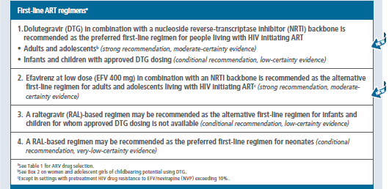
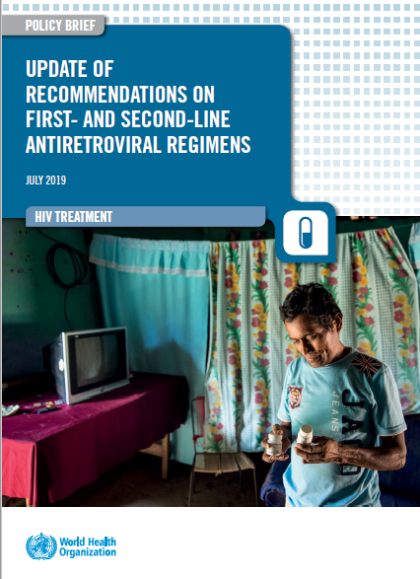
2019 WHO recommendations: First-line ART regimens

Slide 11
Safety and Efficacy of DTG and EFV₆₀₀ in 1st line ART
(summary 2019 WHO Sys Review & NMA)
major outcomes | DTG vs EFV₆₀₀ | _{quality of evidence}
Treatment discontinuation (any or due AEs) | DTG better | high
Viral suppression (4-96 weeks), viral suppression at delivery (PW), transmission (PW) | DTG probably better | high to moderate
CD4 recovery (24-144 weeks) | DTG probably better | high to moderate
Mortality | comparable | low
Neuropsychiatric AEs (any grade), depression (grade 3 or 4), dizziness (any grade) | DTG probably better | moderate to low
Sleep disorders (any grade) | comparable | very low
Body weight gain | EFV probably better | moderate
NTD | EFV may be better | low
HIVDR (overall, NRTI or anchor drug) | DTG probably better | high to moderate
Efficacy outcomes
Tolerability, safety & resistance outcomes
Reference: Steve Kanters, For WHO ARV GDG, 5-7 June 2019
Notes:
Evidence: The NMA showed that DTG, was superior to EFV in terms of viral suppression, CD4 recovery and treatment discontinuation. EFV400 was better than EFV 600 in terms of CD4 recovery and treatment discontinuation, but comparable in terms of viral supression. DTG was betetr than EFV400 in terms of viral suppression and treatment discontinuation. All regimens were comparable in terms of mortality, disease progression and occurrence of SAE. The quality for this evidence was rated according GRADE methodology.
Research gaps: There are concerns on NTD potential risk with DTG if used in the early pregnancy and during the preconception period.

Slide 12
Safety and Efficacy of EFV₄₀₀ and EFV₆₀₀ in 1st line ART (PICO 3)
(summary 2019 WHO Sys Review & NMA)
major outcomes | EFV₄₀₀ vs EFV₆₀₀ | _{quality of evidence}
Treatment discontinuation (due AEs) | EFV400 better | high to moderate
Viral suppression (48-96 weeks), VL suppression if baseline > 100,000 (48 weeks) | comparable | moderate
CD4 recovery (24-96 weeks) | comparable | moderate
Mortality | comparable | low
Neuropsychiatric AEs (any grade), depression (grade 3 or 4), dizziness (any grade), sleep disorders (any grade) | comparable | low to very low
Body weight gain | comparable | low
Treatment related adverse events | EFV400 better | moderate
HIVDR (overall, NRTI or anchor drug) | comparable | very low
Efficacy outcomes
Tolerability, safety & resistance outcomes
Reference: Steve Kanters, For WHO ARV GDG, 5-7 June 2019
Notes:
Evidence: The NMA showed that DTG, was superior to EFV in terms of viral suppression, CD4 recovery and treatment discontinuation. EFV400 was better than EFV 600 in terms of CD4 recovery and treatment discontinuation, but comparable in terms of viral supression. DTG was betetr than EFV400 in terms of viral suppression and treatment discontinuation. All regimens were comparable in terms of mortality, disease progression and occurrence of SAE. The quality for this evidence was rated according GRADE methodology.
Research gaps: There are concerns on NTD potential risk with DTG if used in the early pregnancy and during the preconception period.

Slide 13
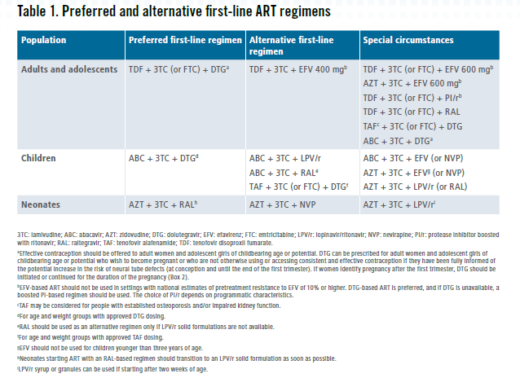
2019 WHO recommendations: First-line ART regimens

Slide 14
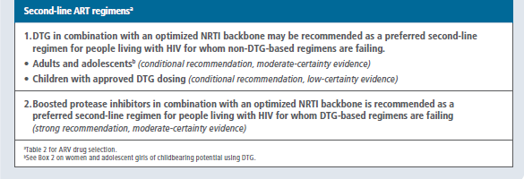
2019 WHO recommendations: Second-line ART regimens

Slide 15
Safety and Efficacy of DTG and PIs (LPVr) in 2nd line ART
(summary 2019 WHO Sys Review & NMA)
major outcomes | DTG vs LPVr | _{quality of evidence}
Viral suppression (4-96 weeks) | DTG better | high
Viral suppression baseline VL > 100,000 (48 weeks) | comparable | moderate
CD4 recovery (24-48 weeks) | comparable | moderate
Mortality | comparable | low
Neuropsychiatric AEs (any grade) | comparable | low
Treatment related SAE | comparable | low
Treatment emergent AE, related AEs | DTG probably better | high
Treatment discontinuation (any or due AEs) | DTG probably better | high
HIVDR ( overall) | comparable | very low
Efficacy outcomes
Tolerability, safety & resistance outcomes
Reference: Steve Kanters, For WHO ARV GDG, 5-7 June 2019
Notes:
Evidence: The NMA showed that DTG, was superior to EFV in terms of viral suppression, CD4 recovery and treatment discontinuation. EFV400 was better than EFV 600 in terms of CD4 recovery and treatment discontinuation, but comparable in terms of viral supression. DTG was betetr than EFV400 in terms of viral suppression and treatment discontinuation. All regimens were comparable in terms of mortality, disease progression and occurrence of SAE. The quality for this evidence was rated according GRADE methodology.
Research gaps: There are concerns on NTD potential risk with DTG if used in the early pregnancy and during the preconception period.

Slide 16
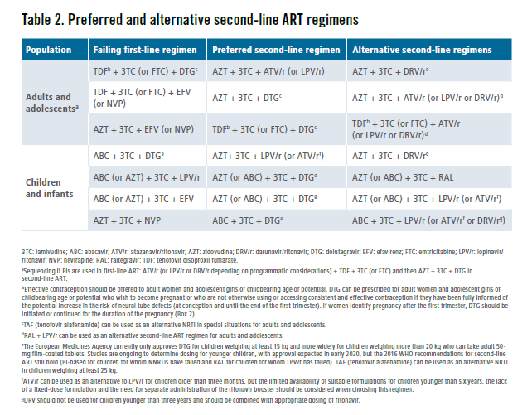
2019 WHO recommendations: Second-line ART regimens

Slide 17
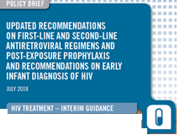
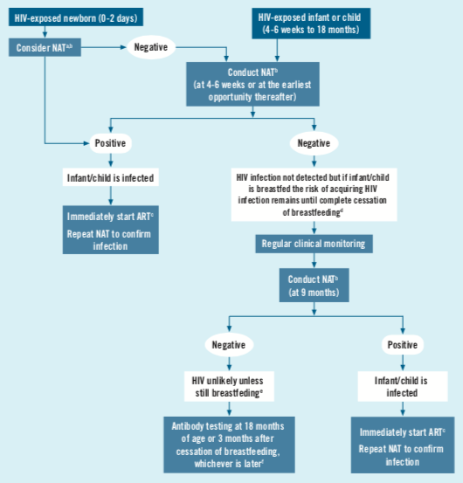
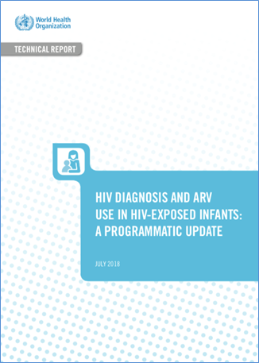

Children- WHO 2018 recommendations and guidance
Simplify and optimize diagnostics
Introduce DTG as soon as possible
Use the most potent non-NNRTI option
Move away from NNRTI-based regimens
 | NEONATES | CHILDREN
Preferred | AZT+3TC+RAL¹ | ABC+3TC+DTG²
Alternatives | AZT+3TC+NVP | ABC+3TC+LPV/r ABC+3TC+RAL¹
Special circumstances³ | AZT+3TC+LPV/r | ABC (or AZT)+3TC+EFV ABC (or AZT)+3TC+RAL AZT+3TC+LPV/r AZT+3TC+RAL AZT+3TC+NVP
Introduction of indeterminate range for EID
Moving to a multi-HIV NAT algorithm : Birth (where of value) + 6 weeks + 9 months + any time HIV exposed infants present sick
Ensuring confirmatory testing of a positive NAT result is undertaken
Diagnosis is not completed without “final diagnosis” at the of the period at risk for transmission
¹ For the shortest time possible, until a solid formulation of LPV/r or DTG can be used
² For age and weight groups with DTG approved dosing (50 mg adult tablet from 20 kg TLD can be used in adolescents weighting more than 30 kg)
and where LPV/r is not available
³ In cases where no other alternatives are available
Notes:
This table summarizes the new WHO guidelines which recommend the use of integrase inhibitors across age groups with RAL/AZT/3TC recommended when starting treatment in the first 4 weeks of life and DTG/ABC/3TC for the rest of the paediatric population
In children for whom approved DTG dosing is not yet available RAL can e considered as an alternative regimen, particularly where LPVr is not available
Use of NNRTI based regimen is now reserved for special circumstances where no other alternatives can be used

Slide 18
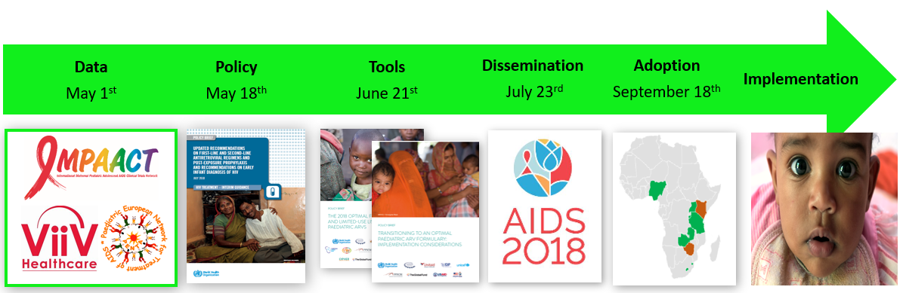


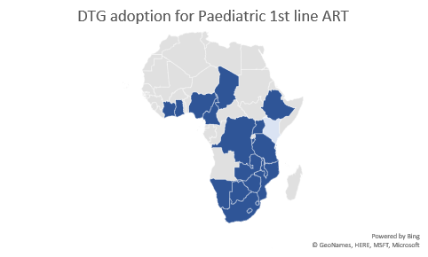
Introducing DTG for children and adolescents in 2018/19
FIVE common challenges
  Access to SRH services limited
  Age of consent policies limit access
  Limited supplies of contraceptives
  Information on DTG use not adolescent friendly
  Cultural norms that stigmatize use of contraceptives
In January 2019, the WHO-convened Paediatric ARV Working group reviewed data from the ODYSSEY trial and formally endorsed the use of 50 mg film-coated tablets for all children above 20 kg.
As of June 2019, 20 of the 21 priority countries for paediatric HIV have adopted DTG for children and it’s estimated that about 500,000 children can now start or transition to a more durable ART regimen

Slide 19
Children - Transition to optimal regimens
Current regimen | Weight | Optimal regimen for transition | Considerations
AZT/3TC/NVP AZT/3TC/EFV ABC/3TC/NVP | <20 kg | ABC/3TC/LPVr | If still stable these can be transitioned to DTG when they reach 20 kg
 | 20-30kg | ABC/3TC/DTG | If still stable these can be transitioned to TLD when they reach 30 kg
 | > 30kg | TLD | -
ABC/3TC/EFV | <20 kg | No change until reach 20 kg unless treatment failure occurs | Of value once reached 20 kg when DTG can be used so that OD administration is preserved.
 | 20-30kg | ABC/3TC/DTG | If still stable these can be transitioned to TLD when they reach 30 kg
 | > 30kg | TLD
ABC/3TC/LPVr AZT/3TC/LPVr | <20 kg | No change until reach 20 kg unless treatment failure occurs | Important to ensure use of tablets as soon as possible to reduce pill burden. Transition from AZT/3TC/LPVr to ABC/3TC/LPVr can also be considered to reduce pill burden
 | 20-30kg | ABC/3TC/DTG | If still stable these can be transitioned to TLD when they reach 30 kg
 | > 30kg | TLD | -
Goal of transition
  Improve outcomes
  Harmonization
  Simplification
  Supply security
Children eligible for transition
  Already on ART
  Clinically stable (defined as per national guidelines)
  Prioritize children on NNRTI based regimen

Slide 20
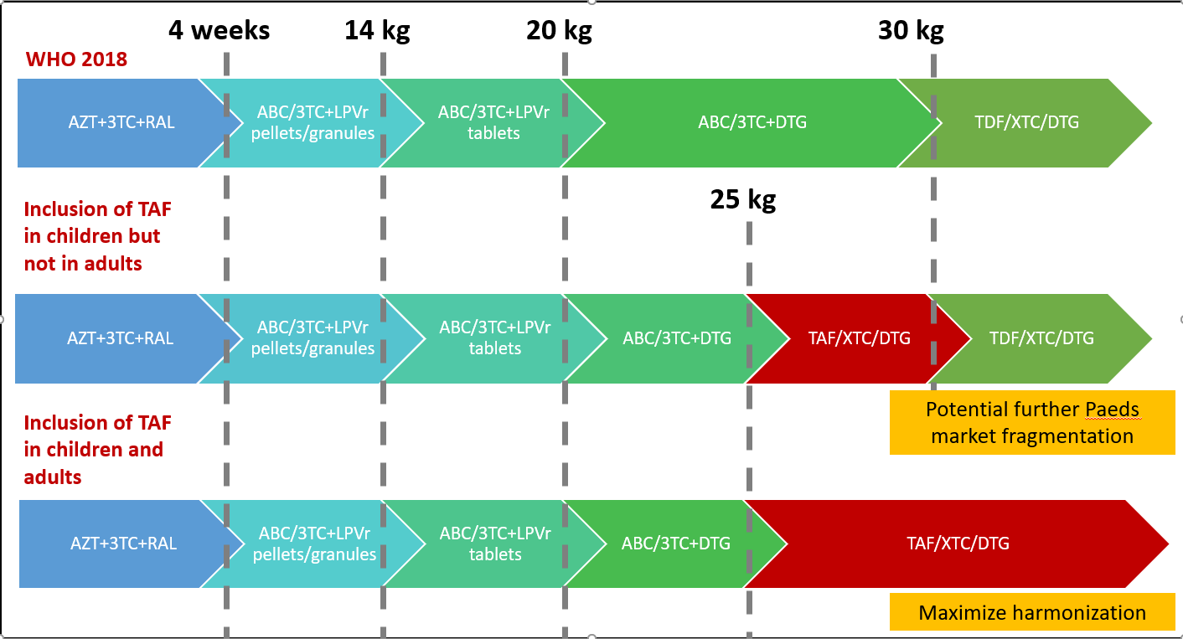
TAF becoming an option for NRTI backbone
Improved durability and sequencing (more favourable resistance profile)
Reduction in adverse impact on bone and renal health
  Bone accretion throughout childhood with peak in puberty
  Multiple factors impacting bone health including nutrition, HIV and HIV treatment
Children co-infected with HBV (~8-10% among children with HIV in SSA) are not receiving treatment for Hep B.
Adult formulations of TAF can be used in children over 25 kg

Slide 21
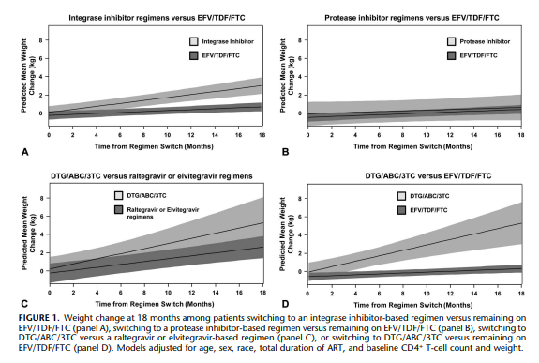
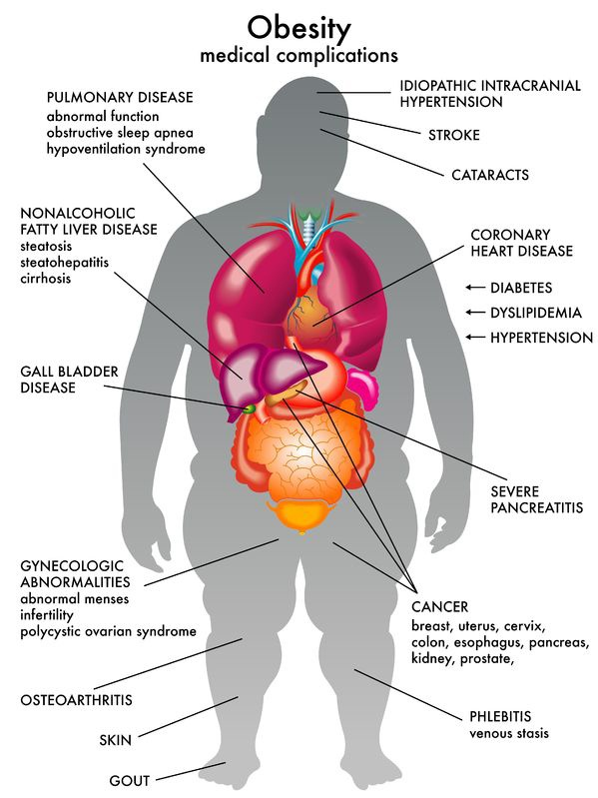
INSTI and new story of weight gain among PLHIV

Slide 22

832 women aged 15-72 from 94 countries took part in the online survey, and 434 (52%) responded to the optional treatment section.
Of the 381 (88%) who were on
treatment, only 52 (11.9%) reported no side effects.
The mean number of ARV side-effects was four including fatigue (64.8%), mood changes (47.1%), headaches (40.6%), body
dysmorphia (40.2%), loss of libido (37.5%), strange dreams (29.9%), and menstrual disorders (24.1%).
Singly or collectively, side-effects strained relationships, led to financial insecurity or poverty, and contributed to mental ill-health, including loneliness, isolation, stress, anxiety, and depression.
Durban2016 TUPED272
Notes:
We draw your attention to the findings of the Global Values and Preference study on treatment sideeffects in general experienced by women living with HIV.
This was commissioned by WHO and shaped the WHO 2017 SRHR Guideline.
These findings were presented as a poster at IAS in Durban in 2016
By salamander Trust

Slide 23
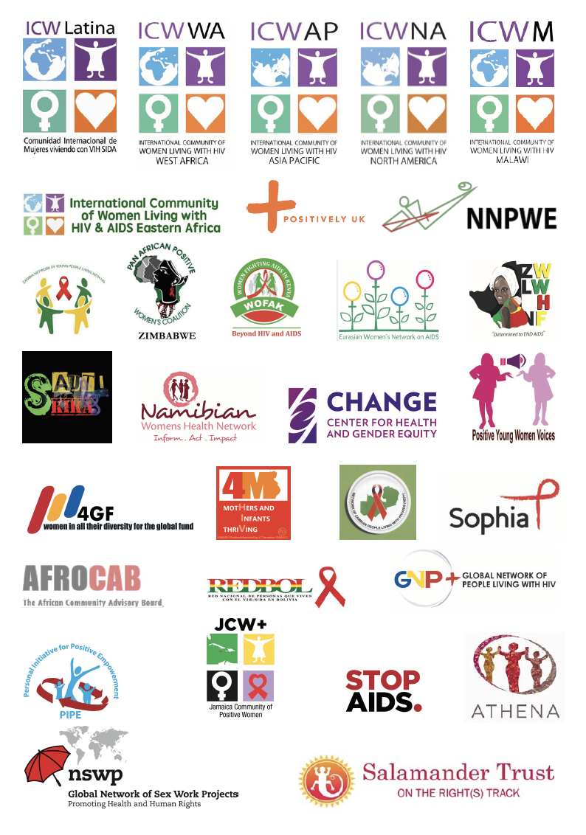
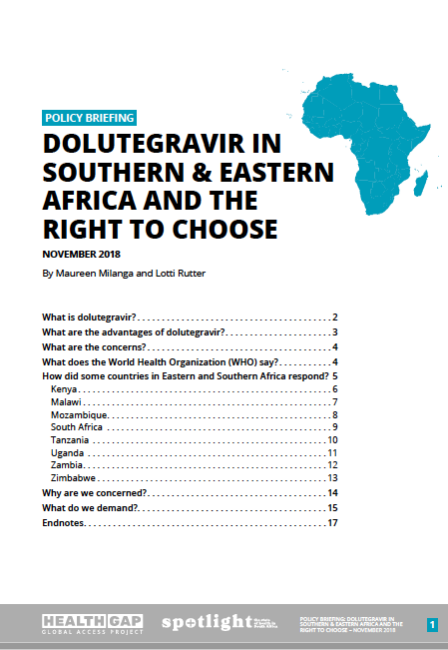

Community Voices Clear
Unanimous decision based on the data currently available that DTG’s benefits – reduced side effects, improved efficacy, and a high barrier to resistance – outweigh its potential risks.
Concluded that blanket exclusions that deny women equitable access to this optimal HIV treatment are not warranted or justified.
Notes:
From DTG advocacy brief https://salamandertrust.net/wp-content/uploads/2019/02/DTG_OurRightsLivesDecisions_Advocacy_Booklet-FINAL_19_Feb2019.pdf
I didn’t mention a lot of in country consultations that were conducted with PLHIV including WLHIV in Zimbabwe, Kenya and many other countries where again women clearly indicate their willingness to use DTG inspite of the potential side effects.

Slide 24
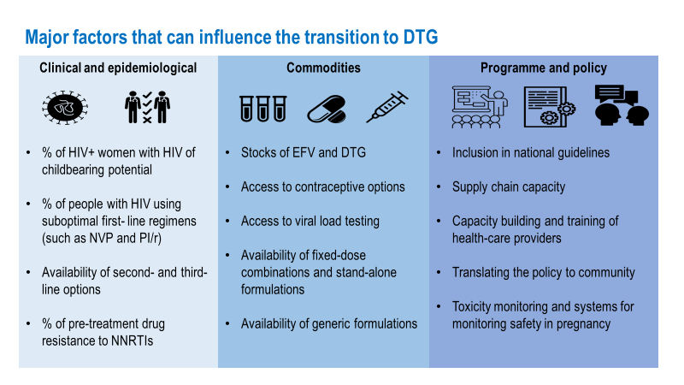

Slide 25
Important drug-drug interactions with DTG
Key drug interaction | Suggested management
Amiodaquine | Use an alternative antimalarial agent
Carbamazepine | Use DTG twice daily or substitute with an alternative anticonvulsant agent
Phenytoin and phenobarbital | Use an alternative anticonvulsant agent
Dofetilide | Use an alternative antiarrhythmic agent
Metformin | Limit daily dose of metformin to 1000mg when used with DTG & monitor glycemic control
Polyvalent cation products containing Al, Ca, Fe, Mg and Zn (eg: antacids, multivitamins & supplements)* | Use 2 hours before or 6 hours after DTG
Rifampicin | Use DTG twice daily or substitute with rifabutin
* There is no drug interaction of DTG with folic acid. However, folic acid is frequently included in multivitamin preparations which may also contain polyvalent cations.

Slide 26
2019 WHO ART Guidelines: What has been changed?
Topic | 2018 interim guidelines | 2019 updates
Use of DTG in 1st line | DTG as preferred option Conditional recommendation Moderate certainty evidence for adults Very low certainty evidence for women of reproductive age (note of caution on DTG and use of effective contraception) | DTG as preferred option Strong recommendation Moderate certainty evidence for all adults (programmatic considerations and informed by risk/benefit analysis for women of reproductive age) Strong focus on women centred approach
Use of EFV in 1st line | EFV 400 and EFV600 as alternative options Conditional recommendation Moderate certainty of evidence Limited evidence on EFV400 efficacy in TB and pregnant women | EFV400 as alternative option (including TB and PW) Strong recommendation Moderate certainty of evidence EFV600 used in special situations
Use of DTG in 2nd line | DTG as preferred option if not used in 1st line Conditional recommendation Moderate certainty of evidence (note of caution on DTG use for women of reproductive age) | DTG as preferred option if not used in 1st line Conditional recommendation Moderate certainty of evidence (informed by risk/benefit analysis for women of reproductive age ) PI as preferred option if DTG used in 1st line Strong recommendation Moderate certainty of evidence

Slide 27
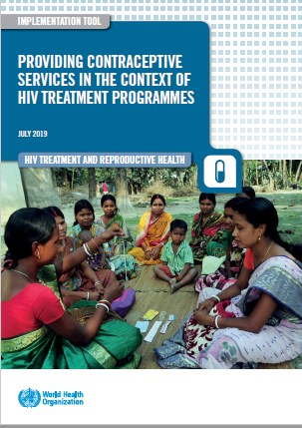
HIV treatment and Contraceptive Services Integration Implementation Tool
ENSURING ACCESS TO INTEGRATED, RIGHTS-BASED, CLIENT-CENTRED, HIGH-QUALITY CONTRACEPTIVE CARE
ENSURING CONTRACEPTIVE OPTIONS AND EFFECTIVENESS FOR WOMEN AND ADOLESCENT GIRLS LIVING WITH HIV
CONTRACEPTIVE CONSIDERATIONS FOR WOMEN AND ADOLESCENT GIRLS RECEIVING ART
CONTRACEPTIVE CONSIDERATIONS ACROSS THE LIFE-COURSE IN HIV TREATMENT PROGRAMMES

Slide 28

Guiding Principles for providing quality contraceptive care for women living with HIV
Human rights – based
Client access to evidence-based information on the advantages and disadvantages of different contraceptive methods
Confidentiality and privacy
Client decision-making without coercion or judgement
Technically competent health workers
An appropriate constellation of services (including follow-up) that are available in the same locality

Slide 29
CONTRACEPTIVE CONSIDERATIONS ACROSS THE LIFE-COURSE IN HIV TREATMENT PROGRAMMES
Special Considerations
Post-partum contraception
Future pregnancy plans discussion
Women older than 40 years
Women and adolescent girls who want pregnancy
Adolescent girls
Move from a one-size-fits-all approach to one that responds to the varying needs of different groups of adolescents
Expand the range of contraceptive choices offered to adolescents
LARCS (implants or IUD) may be more convenient and effective (but not for everyone)
Right to privacy and confidentiality in health matters
Make existing health services more adolescent friendly

Slide 30
New WHO HIV Tx App
Get online with WHO ARV and Treatment Guidelines - 2019
https://hivtx.org
https://hivtx.org/iphone
https://hivtx.org/android
This is a Beta Launch-- We want your feedback!

Slide 31
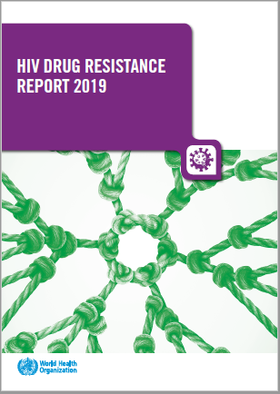
Other docs to be launched at IAS

Slide 32
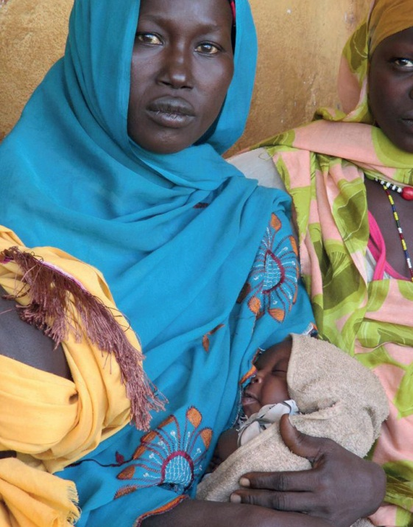
Acknowledgements
All members Guidelines Development Group members
Elaine Abrams & Serge Eholie
Tamara Kredo
WHO Treatment and Care team
Marco Vitoria
Martina Penazzato
Francoise Renaud
Nathan Ford
Silvia Bertagnolio
Lara Vojnov
Vindi Singh
Morkor Newman
Serena Brusamento
Chantal Migone
Ajay Rangaraj
Anisa Ghadrshenasa
PEPFAR, Unitaid, Global Fund, Gates, CDC, USAID, UNAIDS, UNICEF
AFROCAB, iBASE, ITPC, Salamander Trust, ICW, GPN+, APN+

